Slide 1
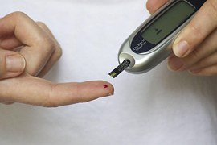
CAPSTONE PROJECT · DATA SCIENCE
Predicting Diabetes Risk from Health Survey Data
Can lifestyle and health indicators flag who needs diabetes screening first?
Connor Miller
Institute of Data · August 2026
Dataset: CDC BRFSS 2015 (UCI ID 891)
DIABETES RISK CAPSTONE | CONNOR MILLER
1
Notes:
Kia ora everyone, I'm Connor Miller. Today I'm presenting a project that looks at whether lifestyle and health indicators can help flag who should be prioritised for diabetes screening.

Slide 2


Introduction
About me
Agenda
• Connor Miller, 25
• Bachelor of Laws and Bachelor of Science (Psychology), 2019-2024
• Practised law for over two years
• Now applying that analytical training to data science
• Business context, stakeholders, and value
• Dataset, industry practice, and New Zealand relevance
• Exploratory Data Analysis(EDA). and feature design
• 27 models across three feature sets
• What the results mean, conclusions, and what I would do differently.
DIABETES RISK CAPSTONE | CONNOR MILLER
2
Notes:
Quickly, a little about me: I studied a Bachelor of Laws and a Bachelor of Science majoring in Psychology at the University Of Canterbury, and then went on to practise law for two years.
Today’s agenda is straightforward. I’ll walk through the business problem, talk about the dataset, highlight the key findings from the exploratory data analysis also known as EDA, outline the machine learning models I used and explain their results and what they mean in a practical sense, and then finish with the project’s conclusions including what I’d do differently if I were to approach this project again.

Slide 3
Bigger picture – Diabetes's industry and New Zealand
Industry practice
• This sits in public health and chronic disease prevention, not hospital diagnosis
• Health systems need earlier triage because screening everyone is not practical.
• Lifestyle and health survey data can help prioritise confirmatory testing.
Why a US survey still matters
• BRFSS is a large, established population health survey model.
• BMI, blood pressure, activity, and self-reported health appear in many health systems.
• Useful proof of concept for risk scoring from routinely collected survey data.
New Zealand relevance
• Diabetes is a major burden in Aotearoa New Zealand.
• A similar triage approach could support primary care and public health planning for diabetes.
• Local data and clinical partners would be needed before any real deployment and implementation of a machine learning model.
DIABETES RISK CAPSTONE | CONNOR MILLER
5
Notes:
In 2015, about 415 million people worldwide were living with diabetes, and this number is expected to rise past 640 million by 2040. So this is a growing health concern. For this project, we are primarily focused on type 2 diabetes, because research shows that this form of diabetes is strongly linked to lifestyle choices.
In terms of industry practice, this work sits within public health screening rather than hospital diagnosis. We are not replacing doctors. Rather we are building a model to help identify who should be screened first, then those who are screened as at risk of diabetes can receive further confirmatory testing.
A quick note on why a US survey still matters. BRFSS is a large, established population health survey. Predictors like BMI, blood pressure, physical activity, and general health appear in many health systems across the world, so it works well as a proof of concept for risk scoring based on routinely collected data.
For New Zealand, diabetes is a major health concern. A similar triage approach could support primary health care and public health services. But before deploying a risk screening tool here, we would need to train the model on New Zealand data

Slide 4
Business problem
Business context
• Diabetes is a major public health issue - common, costly, and linked to serious complications.
• Often identified too late; clinical screening can be expensive and resource-intensive.
• Health and lifestyle data may help identify higher-risk individuals earlier.
• Stakeholders: public health orgs, clinicians, and individuals.
Business question
• Can health and lifestyle indicators be used to predict diabetes risk more effectively?
• Focus: better targeting of screening - not clinical diagnosis.
Why it matters
• Supports earlier intervention.
• Helps target screening resources more efficiently.
• May reduce long-term healthcare costs and complications.
DIABETES RISK CAPSTONE | CONNOR MILLER
3
Notes:
The business context is that diabetes is a major public health concern. It is common, costly, and linked to serious health complications. It is often identified too late, and clinical screening for everyone is expensive and resource intensive. Health and lifestyle data may help identify higher‑risk people earlier.
Stakeholders matter here. Public health organisations care because late diagnosis leads to complications and puts pressure on the system. Clinicians, such as GPs and nurses, want a clear risk flag that supports referral decisions without replacing their judgement. Individuals benefit from earlier awareness and prevention.
The business question is whether health and lifestyle indicators can be used to predict diabetes risk more effectively. The focus is better targeting of screening, not clinical diagnosis.
This project matters because earlier intervention leads to better health outcomes, screening resources can be used more efficiently, and long‑term healthcare costs and complications may be reduced.

Slide 5

About The Data Set
Dataset snapshot
• Source: CDC BRFSS 2015 via UCI (Dataset ID 891)
• 253,680 survey responses and 21 predictor variables.
• Target: Diabetes_binary - 0 = no diabetes, 1 = prediabetes or diabetes.
Class Imbalance 84.3% of respondents did not have diabetes, 15.3% did have diabetes.
• Includes BMI, blood pressure, cholesterol, lifestyle, self-reported health, and demographics.
Data question
• Can health and lifestyle data predict diabetes risk well enough for screening triage?
Key limitations
• Self-reported data, combined diabetes/prediabetes target, unweighted analysis.
• Later BRFSS releases can be used for retraining and validation.
DIABETES RISK CAPSTONE | CONNOR MILLER
4
Notes:
The dataset I used is the Centres for Disease Control and Prevention Behavioural Risk Factor Surveillance System, sourced from UCI. It contains about 254,000 responses and 21 predictors, including BMI, blood pressure, cholesterol, lifestyle factors, and demographical factors.
There is one important caveat. combines prediabetes and diabetes into a single class. So what we are predicting is a general risk flag for triage, with a practical focus onlifestyle‑related risk.

Slide 6
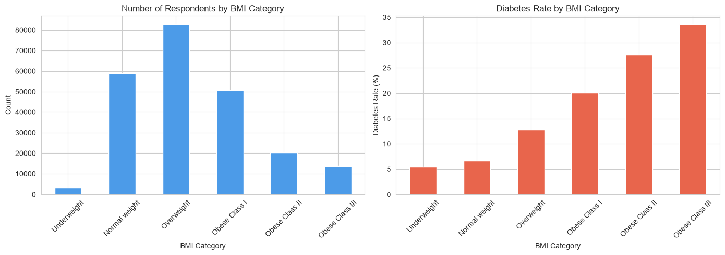
EDA highlights - BMI
Key takeaways
• Most respondents sit in overweight and obese BMI groups.
• Diabetes rate rises steadily as BMI category increases.
• Higher BMI is one of the strongest predictors in the data set.
• BMI is a practical screening feature because it is widely available.
DIABETES RISK CAPSTONE | CONNOR MILLER
6
Notes:
Starting with the EDA, the first key variable is BMI. Most people in the dataset are either overweight or obese, and as BMI increases, diabetes rates increase alongside it. This is especially important for type 2 risk, and it makes BMI one of the strongest and most practical signals in the data.

Slide 7
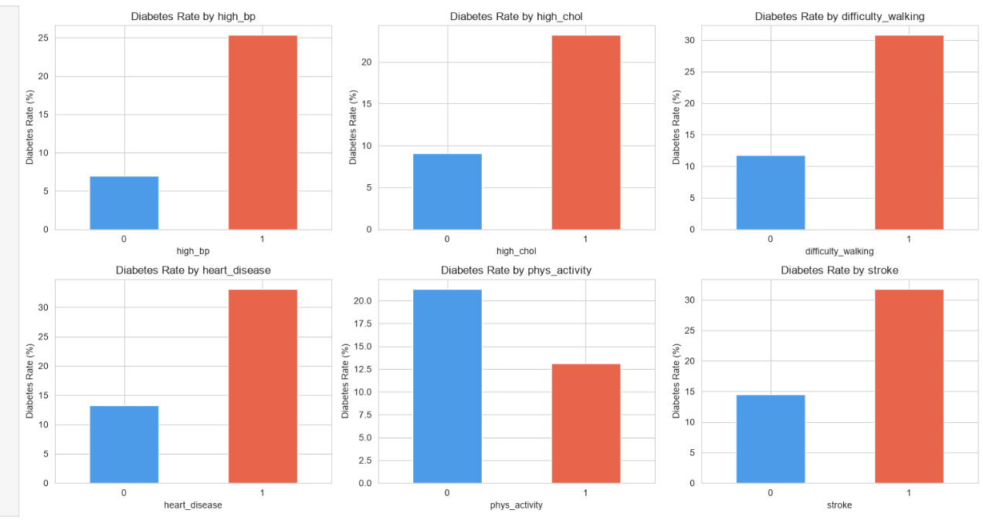
EDA highlights - health conditions & activity
Key takeaways
• Higher diabetes rates with high BP, high cholesterol, heart disease, stroke, and difficulty walking.
• Lower diabetes rates for people who were physically active.
• Health conditions and activity both matter for diabetes screening.
• These patterns support using clinical + lifestyle features together for modelling.
DIABETES RISK CAPSTONE | CONNOR MILLER
7
Notes:
Next, looking at health conditions and activity. Diabetes rates are higher among people with high blood pressure, high cholesterol, heart disease, stroke, and difficulty walking. Rates are lower among people who were physically active. This shows that both clinical factors and lifestyle factors play an important role in screening.

Slide 8
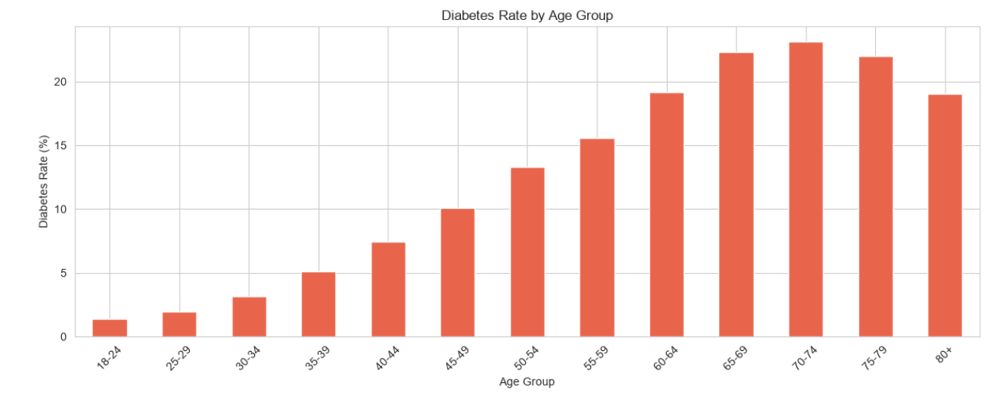
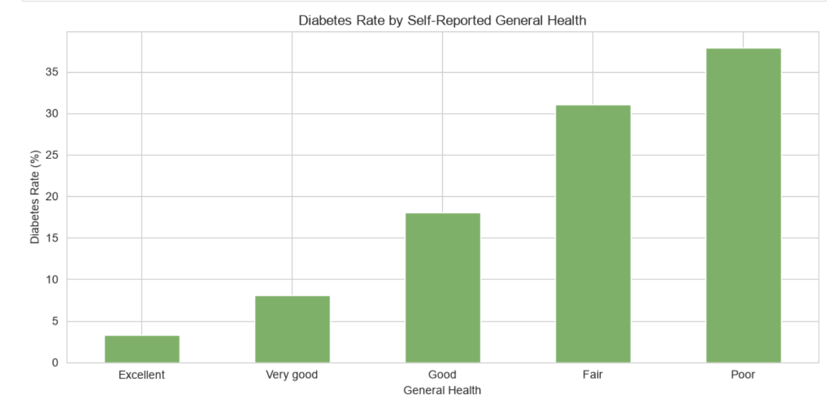
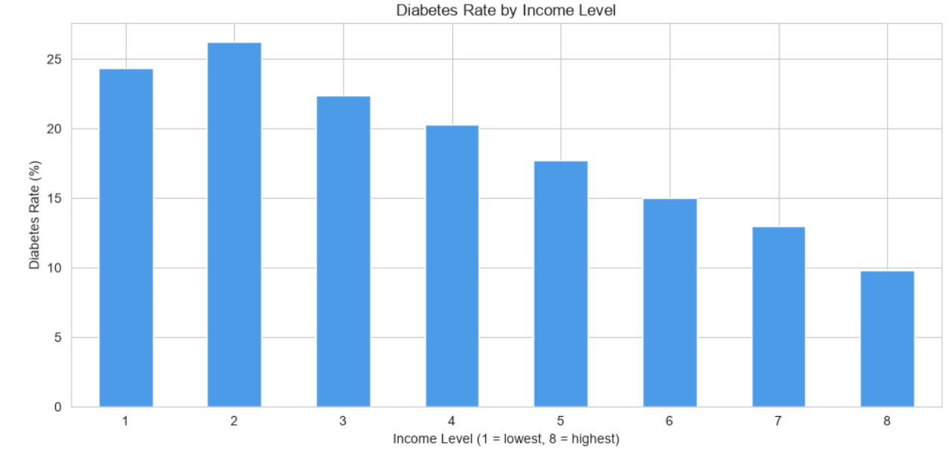
EDA highlights - age, income, general health
Key takeaways
• Diabetes rates increase with age
• Lower-income groups show higher diabetes rates
• Poorer general health is linked to much higher diabetes risk
• Age, income, and general health are useful features within the project.
DIABETES RISK CAPSTONE | CONNOR MILLER
8
Notes:
Age, income, and general health also stand out. Diabetes rates rise with age. Lower‑income groups show higher rates. Poorer self‑reported general health is linked with much higher risk. These are also useful triage signals that sit alongside the clinical ones.

Slide 9
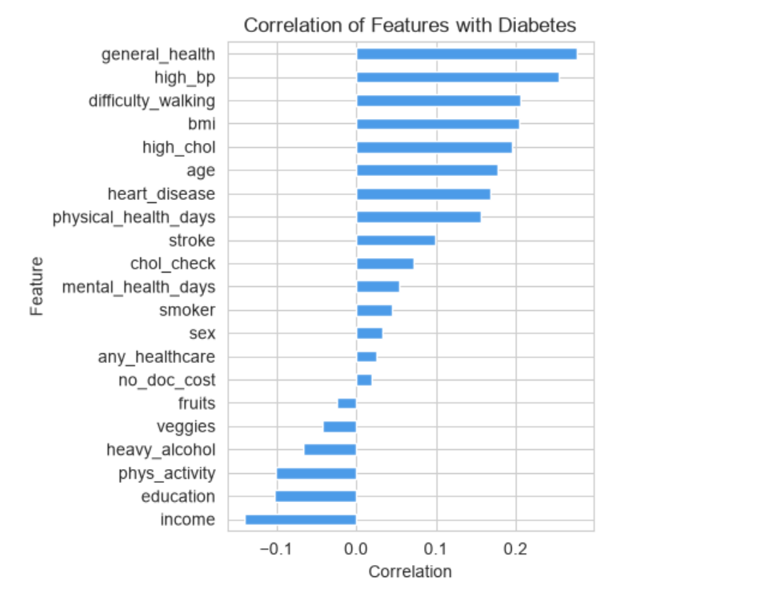
EDA highlights - correlations with diabetes
Key takeaways
• General health had the strongest correlation with diabetes
• High BP, BMI, cholesterol, difficulty walking, and age also mattered
• Stronger correlations helped cut the feature set.
DIABETES RISK CAPSTONE | CONNOR MILLER
9
Notes:
General health had the strongest relationship with diabetes. High blood pressure, BMI, cholesterol, difficulty walking, and age also showed clear relationships with diabetes.

Slide 10
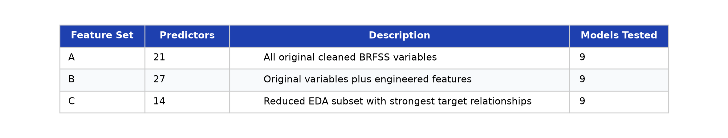
Feature selection & engineering
Engineered features from EDA
Three feature sets compared
• BMI category - groups continuous BMI into risk bands
• Risk factor count - totals key clinical and lifestyle risks
• Overall health burden - combines health and mobility signals
• Built to test whether engineered features improve screening performance
• Set A: all 21 original predictors
• Set B: all features plus engineered features (27 total)
• Set C: strongest EDA-selected features (14 total)
• Goal: find the simplest set that still catches risk well
DIABETES RISK CAPSTONE | CONNOR MILLER
10
Notes:
From the EDA, I built three engineered features: BMI category, risk factor count, and overall health burden. After that, I created three feature sets.
Feature Set A includes all 21 original features. Feature Set B adds the engineered features, bringing the total to 27. Feature Set C keeps the strongest 14 predictors identified in the EDA.
The goal is to find the simplest feature set that still captures risk effectively

Slide 11
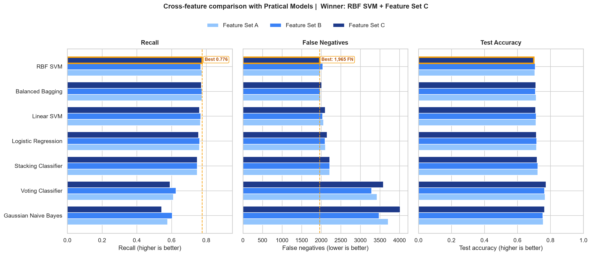
Results across feature sets A, B, C
What stood out
• RBF SVM and Balanced Bagging were the strongest practical models
• Feature Set C + RBF SVM had the best recall and fewest false negatives
• Feature engineering in Set B did not clearly beat the original features
• Some high-recall ensembles flagged almost everyone and were rejected.
• Winner: RBF SVM on Feature Set C
0.776
1,965
14
27
Recall (Set C)
False negatives
Predictors
Models tested
DIABETES RISK CAPSTONE | CONNOR MILLER
11
Notes:
This is the results slide, so I will slow down here and explain the terms properly.
I tested nine models on each of the three feature sets, which means twenty‑seven models in total. The big numbers on the slide are for the best performer: recall of 0.776, 1,965 false negatives, fourteen predictors, and twenty‑seven models tested overall.
Accuracy is the overall percentage of predictions that are correct. It sounds like the main score, but in this context it can be misleading. Most people in the survey do not have diabetes, so a model can say “not at risk” for almost everyone and still look reasonably accurate, while missing the people we actually care about.
That is why I focused on recall. Recall asks: of the people who truly are at risk, how many did the model catch? A recall of 0.776 means about seventy‑eight percent, or roughly four out of five true cases.
False negatives are the people we missed. These are individuals who were at risk, but the model predicted that they were not. In this case, that is 1,965 people. For screening, those misses matter the most.
Precision is the other side of the story. Of the people the model flagged, how many truly were at risk? If precision is lower, you get more false alarms and more
That can be annoying, but it is usually less harmful than missing someone who actually at risk.
I also tested ensemble methods, which combine several models rather then using one model. Some of these achieved extremely high recall, but they did it by flagging almost everyone, which makes them unusable in practice.
The best model was the RBF SVM on Feature Set C. SVM stands for support vector machine. In simple terms, it draws a boundary between higher‑risk and lower‑risk people. The RBF version allows that boundary to flex, so it can capture more complex patterns than a straight line. That is why it outperformed the simpler linear models on recall. Feature Set C used only fourteen predictors and still delivered the strongest results. The engineered features in Set B did not clearly outperform that.
So the best practical model was not the flashiest one. It was the RBF SVM using the least amount of features, well‑chosen set of predictors.

Slide 12
What Results Mean
Takeaway
• Health and lifestyle features can reliably flag diabetes risk in survey data
• The best model is the best trade-off - not just the highest recall score
Recommended model
• RBF SVM on Feature Set C - recall 0.776 on the test set
• Catches 77.6% of at-risk individuals, with 1,965 missed cases
• Only 14 predictors - simpler to deploy without losing performance
Trade-off
• Precision ~0.31 means more follow-ups, but fewer missed cases
• Perfect-recall models flagged almost everyone - not usable in practice
DIABETES RISK CAPSTONE | CONNOR MILLER
12
Notes:
So what do the results actually mean? Survey features can flag lifestyle‑linked diabetes risk. But the best model is not simply the one with the highest recall on paper. It is the one that strikes the best balance between recall and false negatives.
The RBF SVM on Feature Set C is the recommended model as it catches about seventy‑eight percent of at‑risk people, with 1,965 misses, and it is easier to deploy because it only needs fourteen features.
Precision of around 0.31 means that roughly one in three people the model flags are true cases. That leads to more follow‑ups, but fewer missed cases, which is the priority for this screening model.
The models that achieved perfect recall were not practical because they flagged almost everyone as having diabetes.

Slide 13
Answering the questions
Business question
• Can health and lifestyle indicators predict diabetes risk more effectively?
• Answer: Yes - Feature Set C + RBF SVM gives a practical screening signal
• Supports screening prioritisation - not clinical diagnosis
Data question
• Can health and lifestyle data predict diabetes risk?
• Answer: Yes - Recall 0.776 | 1,965 FN | ROC AUC 0.798
• Pipeline: 6 Jupyter notebooks (EDA to features to modelling A/B/C to comparison)
Recommended path
• Deploy RBF SVM on Feature Set C
• Production: BRFSS to features to model to risk flag to clinical follow-up
• Tools: Python, pandas, scikit-learn, imbalanced-learn, Jupyter
DIABETES RISK CAPSTONE | CONNOR MILLER
13
Notes:
Pulling the questions together. The business question was whether health and lifestyle indicators can predict diabetes risk more effectively. The answer is yes, as a screening tool, but the model does not replace clinical diagnosis.
The data question was whether health and lifestyle factors can predict diabetes risk. The results show that they can. The Support Vector Machine with the RBF kernel reached a recall of 0.776, which means the model caught most people who were at risk.
The ROC AUC of around 0.80 summarises how well the model separates higher‑risk from lower‑risk people overall. The accuracy was only about 0.70, which is why accuracy was not used as the main measure of success.
The recommended path for deployment is straightforward: collect survey data, use Feature Set C, apply the RBF SVM, generate a risk flag, and then follow up clinically.

Slide 14
Conclusions and next steps
Conclusions
• Survey data can identify higher-risk individuals for targeted screening
• General health, BMI, age, and blood pressure carry the strongest signal
• Feature Set C + RBF SVM gives the best practical balance of recall and simplicity
Limitations
• Self-reported BRFSS data; US adults only; prediabetes and diabetes merged
• No external validation on a different survey year yet
• Some high-recall models produced unusable numbers of false positives
What I would do differently
• Validate model on later BRFSS releases (2016+)
• Hyperparameter tuning to push recall without blowing up false positives
• Pilot with a GP clinic before any real deployment
DIABETES RISK CAPSTONE | CONNOR MILLER
14
Notes:
To conclude, survey data can identify higher‑risk people for targeted screening, especially where lifestyle‑linked type 2 risk is the main concern. The strongest signals were general health, BMI, age, and blood pressure. The best practical model was Feature Set C with the RBF SVM.
There are limits to keep in mind. The data is self‑reported, it comes from a US survey, the diabetes label is merged, and I have not yet validated the model on later BRFSS years.
If I were to do this project again, I would validate on later BRFSS releases, hyper parameter tune the model more carefully to try and increase accuracy, and run a small pilot with a GP clinic before considering any real deployment.

Slide 15
Thank you
Questions & discussion
DIABETES RISK CAPSTONE | CONNOR MILLER
15
Notes:
Thanks for listening. Happy to take questions on the feature sets, why I prioritised recall, or how this could work in a New Zealand setting.

